Slide 1
Rogue Runners
Red London Games
Commercial confidential
V1.7
Notes:
Rogue Runners is a working title

Slide 2
Rogue Runners combines
The thrill of Overwatch
The depth of Clash Royale
The simplicity of Mario Kart

Slide 3
Narrative
In 2086, the evacuation of the Earth was completed, and the last spaceship carrying Earth’s inhabitants left for Kepler 780, its destination, and new home
The meteor that was to strike the Earth was partially deflected at the eleventh hour by a salvo of nuclear missiles, and in the end only a chunk of the meteor hit the Earth, avoiding its obliteration

Slide 4
Narrative
The mysterious meteor had strange effects on the Earth and changed some of the fundamentals laws of physics allowing humans to do things previously thought impossible
You’re one of the few thousands humans who, for one reason or another, decided not to board the last spaceship

Slide 5
Mission
You’re a scavenger and the abandoned Earth is your playground
You live in a home base
An AI system called Two-2 detects when loot and supplies are located and sends you on missions to retrieve them, however other scavengers might get there first
You race to get to the loot first
A mission lasts about 2 to 2.5 minutes

Slide 6
Mission Locations
At launch, there will be 4 locations. One for training and 3 others. More will be added later
When playing online, the mission location is selected randomly on match start. This means that it’s unlikely that you will play the same location twice in a row
Within a location, there are variations:
In some locations, it can rain
Some locations have a night and day version
The last tile is random: mission supplies can be found in an overturned truck, a boxcar, an abandoned hangar, a warehouse, etc.
Notes:
Do all missions occur in the South-West of the USA?

Slide 7
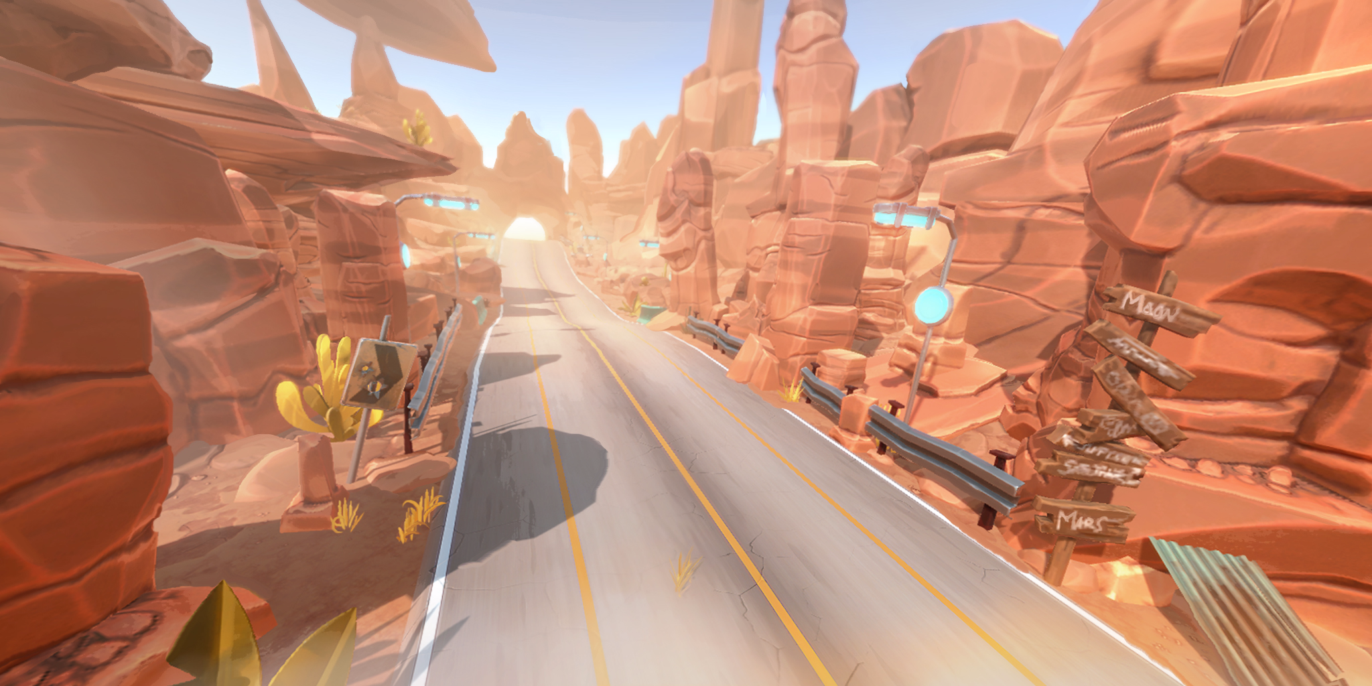
Mission Location: Hanging Rock

Slide 8
Game Mechanics
While running, you can:
Do Moves
Jump by swiping up
Change lanes by swiping left or right or tilting
Slide (including while turning) by swiping down
Queue jumps or slides
Play Cards

Slide 9
Core Game Loop
Race Players
Build your deck
Customize your hero
Collect Rewards

Slide 10
Race rewards
Race loot box if you won
Experience points
Credits (soft currency)
Competitive Points

Slide 11
Death, Health & Respawn
If you die during the mission (ran into an obstacle, got struck by a missile, your health fell to zero, etc.), you will respawn in a safe location
Respawning makes you lose 3 seconds

Slide 12
Emergency boost
If you are losing significantly, you get a once-a-match emergency boost that lasts 15 seconds or so
The boost makes you run faster and your power bar replenishes faster
This allows a player that is losing to make a comeback

Slide 13
Art

Slide 14
Art Style
The game does not take itself too seriously. It’s full of humour and charm
Everything a bit bigger and chunkier than in reality
Vibrant color palette
Heroes have:
strong, recognizable silhouettes
big eyes to convey emotion
an omni-tool

Slide 15
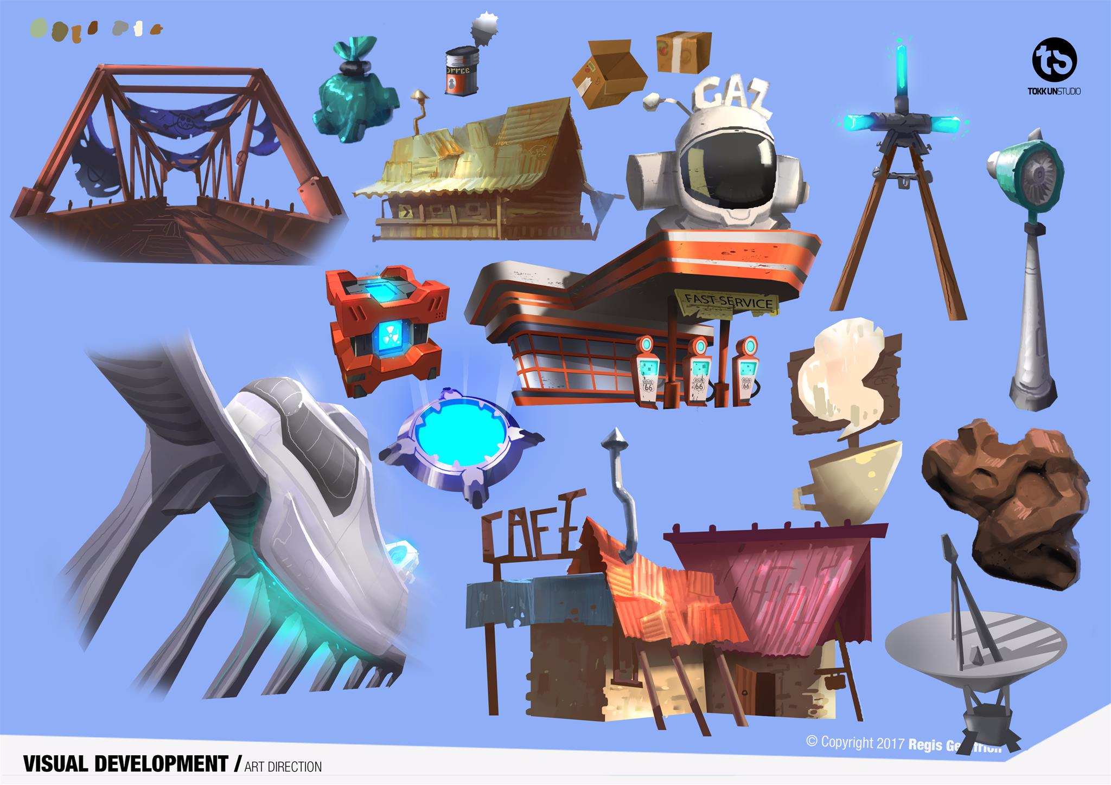

Slide 16
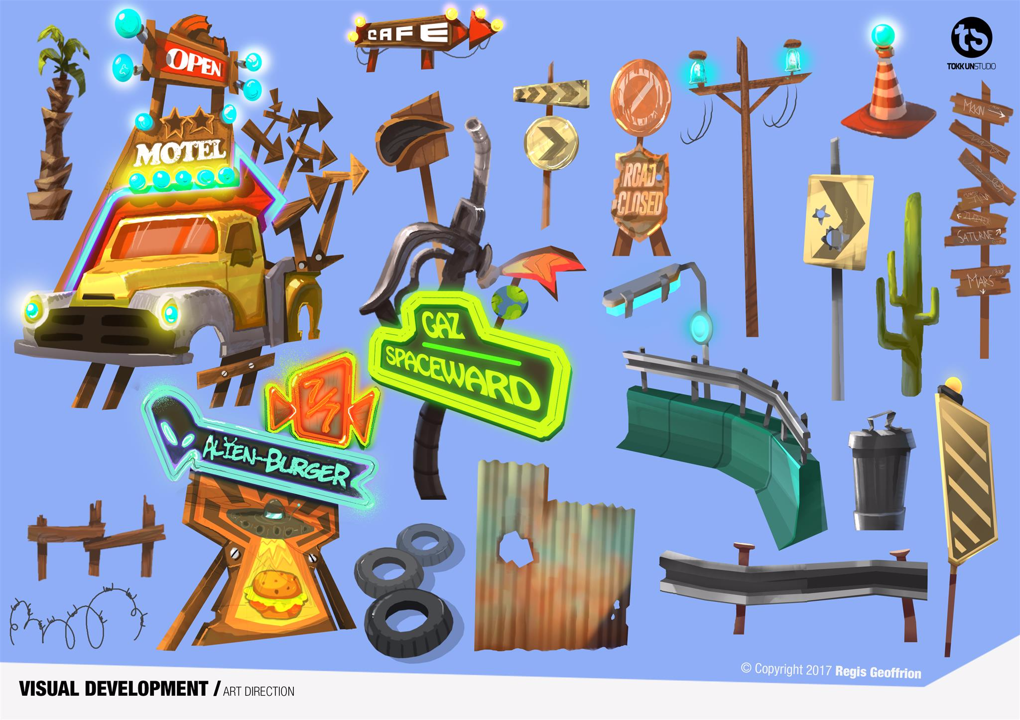

Slide 17
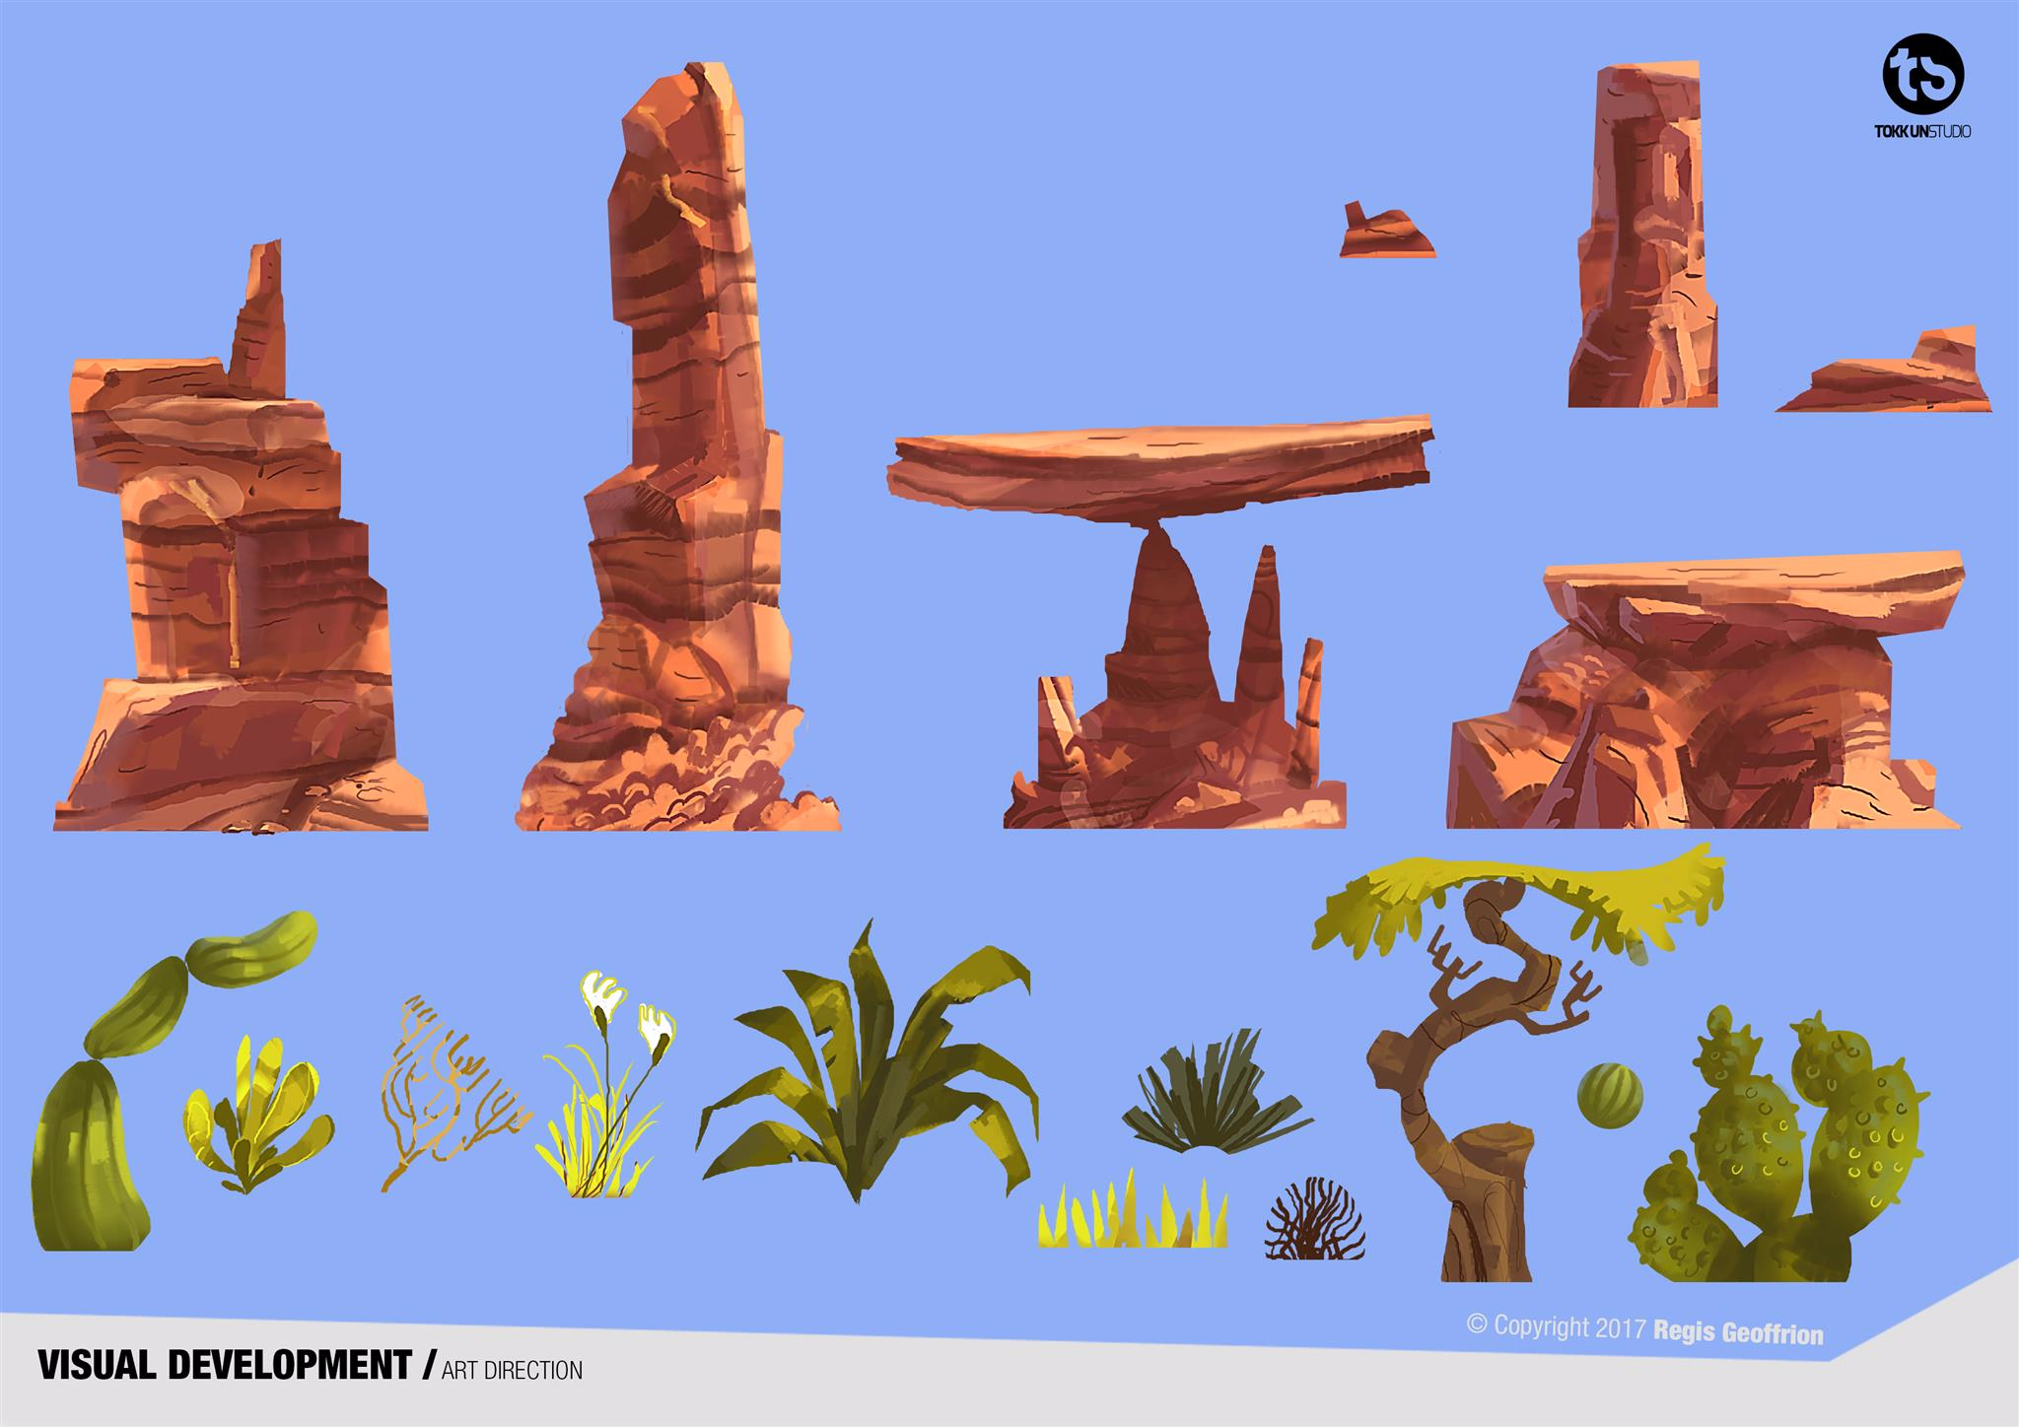

Slide 18
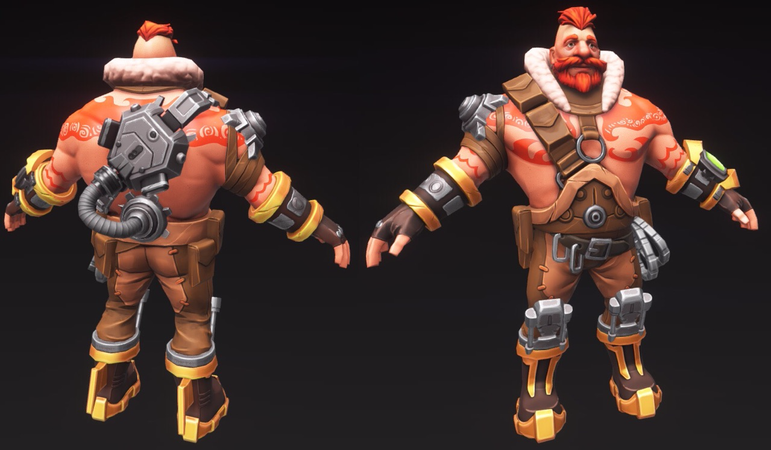
Rug

Slide 19
Your Home Base

Slide 20
Home Base
Every time you win enough trophies, your home base gets automatically upgraded. It looks nicer and gives you status
You can see your current home base in the background of the Main Menu

Slide 21
Home Base
You are matched against players who are of the same skill
Each home base upgrade unlocks new cards
At launch, there will be 5 home base levels. More will be added post-launch

Slide 22
Heroes

Slide 23
Heroes
Characters are heroic and have super-hero skills
They are over-the-top
They can be partially but not completely robots
They have their own unique personality, which is apparent in the model, animations, and voice overs
They have different ethnic backgrounds, body sizes and sexual orientation to show diversity

Slide 24
Heroes – Unique Ability
Each hero has a unique card which reflects their personality
The card associated to your currently selected hero is always in your player deck
You can only use the card if you play with the associated hero
For example, Rug has Shockwave, Gin has Sentry, etc.
The card can be upgraded normally just like any other card

Slide 25
Heroes – Overview
There are initially 6 heroes to chose from. More will be added later
There are no RPG mechanics for Heroes but they can be visually customized
You can select any unlocked hero before a mission in the Hero Selection menu
In the Hero Gallery, each hero appears in a room that represents his or her personality

Slide 26
Heroes – Overview
4 heroes are unlocked from the start. Additional heroes can be purchased or obtained from legendary loot boxes
Each hero skin can be customized to give it a unique sense of style
Heroes have voice lines
Heroes have strong personalities. They are either funny, quirky or snarky. Listening to their voice lines is entertaining

Slide 27

Omni-tool
Each hero wears an arm-computer which is used to trigger defenses or attacks while they are racing

Slide 28
Unique Abilities
# | Hero | Gender | Hero type | Power | Description | Initially unlocked
1 | Bit | F | Genius hacker | Hack | Players can’t use their omni-tool for X seconds | Yes
2 | Rug | M | Tank Teddy-bear | Shockwave | Causes an Earth tremor that damages all players in the vicinity and makes players further away stumble | Yes
3 | Gin | M | Shy robotics engineer | Sentry | Create a sentry that follows you and protects you by shooting at nearby targets | No
4 | Hex | M | Break dancing molecular Engineer | Shrink | Shrink all your opponents to one third of their normal size and make them run more slowly | Yes
5 | Sophia | F | Hippie quantum physicist | Quantum Rift | Create a quantum rift in the sky that sends a meteor flying at your target. | Yes
6 | Brooke | F | Jack-of-all-trades ex-convict | Cloak | Become invisible for a short while. You can’t be targeted by any card or missile. You also run faster while invisible. | No

Slide 29
Hero bios

Slide 30
Bit
Origin: French
Age: 18
Sex: female
Skill: Genius hacker. Can do anything with a computer
Power: Hack
Bit is famous for having hacked into Tetracorp and exposed the company for the environmental disaster they caused. She has quite the reputation among the Dark Internet community. She enjoys reading graphic novels. She never went to school. She is petite. She loves wearing fashion from the late 60s and early 70s.

Slide 31
Rug
Origin: American
Age: 26
Sex: Male
Skill: Strength
Power: Shockwave
He used to work as a docker. He is unbelievably powerful and strong. He’s addicted to tattoos. He has a number of piercings and chains as well. He’s as sweet as a Teddy Bear and wouldn't hurt a fly. He’s vegetarian. His mother passed away just before the last spaceship left.

Slide 32
Gin
Origin: Mexican
Age: 24
Sex: male
Skill: Robotics engineer
Power: Sentry
Gin is very shy and socially awkward. He has a crush on Bit. Feeling lonely, he created his first sentry so it would become his friend. Gin’s sentry is an expressive (think Wall-E or Snowball from Overwatch) hovering robot that follows him around. Gin’s sentry can also fire missiles to protect him.

Slide 33
Hex
Origin: Afro-American
Age: 29
Sex: Male
Skill: Molecular engineer
Power: Shrink
Hex is a molecular engineer. He graduated with top honours. He’s into rap and loves to break dance. He wears a beanie hat. His shoes have fluorescent lights on them.

Slide 34
Sophia
Origin: Swedish
Age: 25
Sex: Female
Skill: Quantum physicist
Power: Quantum Rift
She is a beautiful pagan hippie. She loves wearing flowers in her hair. She craves new age stuff and holding hands naked around a bonfire. Some call her wacky, but when you see her conjure fire out of thin air you are more likely to call her a witch. Others say that she can see the future and has visions of dark things to come. Because of this, she refuses to engage in any serious long-term relationship although she has many suitors. She likes Rug and they hang out a lot.

Slide 35
Brooke
Origin: Croatia
Age: 22
Sex: Female
Skill: Jack-of-all-trades
Power: Cloak
A newcomer to the clan. She just came in one day and dropped her torn backpack in the hangout. Nobody dared ask her to leave. She has a shaved head covered in Sanskrit tattoos. Brooke is dark and brooding. She has a criminal past and was behind bars for a long time. She’s a survivor and prefers being alone. She can understands the beeps of Gin's sentry and often talks with it, but about what, nobody knows. She’s a bad apple. Why she hangs around with this clan is a mystery. She’s petrified with fear on the zipline. Her tattoos are reprogrammable and change everyday

Slide 36
Cards

Slide 37
Blueprints
Each player has a collection of cards
A card can be activated during a match by tapping on it in the turn-ribbon
Cards can be upgraded by collecting blueprints

Slide 38
Card Deck – Overview
New players start with a deck of 7 cards plus 1 hero card for a total of 8
New cards can be purchased when on sale or found in loot boxes
A menu allows you to build your battle deck
It also displays your entire card collection including cards you haven’t found yet

Slide 39
Cards – Turn ribbon
4 cards appear in a turn-ribbon on the side of the screen while on a mission
The next card to become available appears at the bottom of the turn-ribbon. It is smaller
Tap on a card to activate it
Each card cost power
Cards grey out if you don’t have enough power to activate them
Notes:
Maybe mention how the border of the card changes depending on the range of the enemy

Slide 40
Cards – Power bar
The power bar tells you how much power you have available to spend
Power replenishes over time
A match starts with zero power to avoid having cards played in the first few seconds of gameplay

Slide 41
Cards at launch
25 cards will be available at launch. More will be added later
6 of these are Hero cards
7 cards are immediately unlocked as part of the tutorial which corresponds to home base 0
3 cards get unlocked every time the player upgrades his home base. There are 4 home base upgrades.

Slide 42
Cards
# | Card Name | Rarity | Power Cost | Unlock Level From 0 to 4 | Has Secondary Icon
1 | Lightning | Rare | 5 | 2 | No
2 | Fire wall | Common | 2 | 1 | Map
3 | Sprint | Common | 2 | Tutorial (0) | No
4 | Raging Bull | Common | 3 | Tutorial (0) | No
5 | Grenade | Common | 3 | Tutorial (0) | No
6 | Stasis | Rare | 6 | Tutorial (0) | Player
7 | Shrink | Epic | 6 | Hero Card | No
8 | Double Jump | Common | 1 | Tutorial (0) | No

Slide 43
Cards
# | Card Name | Rarity | Power Cost | Unlock Level From 0 to 4 | Has Secondary Icon
9 | Reflect | Legendary | 7 | 3 | No
10 | Trip Mine | Common | 3 | 3 | Map
11 | Steal | Rare | 3 | 3 | No
12 | Sentry | Epic | 6 | Hero Card | Player
13 | Force Field | Rare | 3 | Tutorial (0) | Map
14 | Homing Missile | Rare | 4 | 1 | Map
15 | Freeze | Rare | 5 | Tutorial (0) | Player
16 | Linked Fate | Legendary | 5 | 4 | Player
Notes:
22 cards are completed

Slide 44
Cards
# | Card Name | Rarity | Power Cost | Unlock Level From 0 to 4 | Has Secondary Icon
17 | Supercharger | Rare | 4 | 2 | Player
18 | Hack | Epic | 5 | Hero card | Player
19 | Quantum Rift | Epic | 4 | Hero Card | No ?
20 | Cloak | Epic | 5 | Hero Card | No
21 | Purple Haze | Common | 1 | 4 | Map
22 | Shockwave | Epic | 5 | Hero Card | No
23 | Heal | Common | 2 | 1 | No
24 | Armour | Common | 3 | 4 | No
25 | TBD | Legendary | 5 | 2 | No
Rarity | Total out of 25
Common | 9
Rare | 7
Epic | 6
Legendary | 3
Notes:
Headhunter red crosshair on ground, 0.5 sec to counter with cloak or EMP, always targets 1st person, always works.
Hell storm large scale meteor strike Legendary 10 second 10 mana

Slide 45
Cards – Upgrading
Cards can be upgraded
Upgrading a Raging Bull card for example gives you the following benefits: longer duration and faster speed
Each upgrade cost credits
Each upgrade gives you XP
You need multiple blueprints of the same card to upgrade it. E.g.:
Upgrade Sentry from level 1 to 2 requires 10 blueprints
Upgrade Sentry from level 2 to 3 requires 25 blueprints

Slide 46
Cards – Ranking
There are 4 types of cards:
Common cards have 11 different levels
Rare cards have 9 different levels
Epic cards have 7 different levels
Legendary cards have 5 different levels
Legendary cards will have special animations on them in the future (much like a Legendary Hearthstone card)

Slide 47
Level Up
When you earn enough XP, you level up
There are 100 levels
Any of these actions grants XP:
Finishing a mission (250 xp)
Doing a consecutive race (race needs to start within two minutes of the last race finish) (200 xp)
Winning (500xp)
First win of the day (1500xp)
Upgrading a card. The XP awarded increases with the card level and rarity. Upgrading a common card from level 2 to 3 gives you 5xp whereas upgrading a legendary card from level 4 to 5 gives you 3,200xp
Skill bonuses earned during racing

Slide 48
Skill Bonuses
They reward players who do certain actions:
If your force field zaps an opponent +25xp
If your fire wall fries an opponents +25xp
If you do a double kill +50xp
Etc.

Slide 49
Level Up Rewards
One loot box
A new portrait for your hero icon every 10 levels

Slide 50
Progression System
By winning enough competitive points, your home base gets upgraded automatically to the next level
You are matched with players with the same home base level
Lose too many matches and you will go back down a level

Slide 51
Game modes

Slide 52
Online game modes
Quick Play
Matches you against one player of the same home base level
Location is random
Play with friend
Allows you to play with one friend. You need to know the friend’s user name to invite him or her. The person inviting decides on the location

Slide 53
Offline mode
You can play in PvE against 1 or 2 bots
You don’t gain loot boxes, credits or trophies
You earn the normal amount of XP
You choose the mission location
You can play alone in the training track to practice your moves
You don’t gain loot boxes, credits, trophies or XPs

Slide 54
Co-op mode
You can play with a friend to beat zombie waves together
If you die during a wave, you will go into spectating mode. If your friend also dies, it’s game over. If he survives, you get resurrected when your partner triggers the next wave.
You get a high score based on the number of waves survived and skill points received

Slide 55
Co-op mode
A high score co-op mode is a great way to increase the games virality
You can challenge a friend on Facebook to beat your high score

Slide 56
Zombies Overview
Zombies are displayed on the mini-map as red dots
Zombie waves are manually configured in the level editor and triggered by the player as they run

Slide 57
Killing Zombie
If you slide into a walking zombie, you will topple him and he will die
Most cards are effective against zombies. Toggle the alternate description in the Deck menu to see the differences.
A played card will never negatively affect your partner (i.e. playing shockwave will topple zombies but not your partner)

Slide 58
Zombie types
Normal zombies can be configured to:
Burrow up and walk
Come out of a coffin that opens
Walk or shamble
Run
Follow the player or not
Every X wave, a zombie boss appears that is more difficult. For example, an exploding zombie

Slide 59
Loot Boxes

Slide 60
Loot Boxes – Overview
You earn a loot box:
Every time you level up
When you win a race
As a daily reward, twice a day
You can buy loot boxes in the store
Notes:
Need to replace the word crown

Slide 61
Loot Box Content
Credits
Titanium (not all loot boxes gives Titanium)
Cards
Hero accessories. They have a rarity (Common, Rare, Epic, Legendary). This could be gloves, helmets, boots, etc.
New heroes
Player Icons
Taunt voice lines
Notes:
Need to replace Gems

Slide 62
Opening a loot box
The loot box falls to the ground
The scene background comes from one of the game maps
Your currently selected hero is in the scene and plays an animation to open the loot box and looks delighted when it opens
Notes:
Need to replace Gems

Slide 63
Different types of loot boxes
Type | Acquired by
Level | Changing level
Race Won | Winning a multiplayer race
Store small | Purchasing
Store medium | Purchasing
Store big | Purchasing
Daily free | Free, every 4 hours. Capped to 2.
Notes:
Need to replace Gems

Slide 64
Store
You can buy:
Titanium using $ (hard currency)
Credits using titanium (soft currency)
Loot boxes using titanium
Cards using credits
Hero outfits using credits
Heroes using titanium
Notes:
Replace gem

Slide 65
Video recording and streaming
You can record and share videos of your missions
You can also stream videos of your mission to Mobcrush for example
The video recording uses the iOS Replay Kit and is not available for Android

Slide 66
Social Media
You can invite friends to play if they are online
You have a list of friends
You can also see a list of the most recent players you played against and add them as friends if you want
You can Invite Facebook friends to install the app
You can challenge a friend to beat your zombie high score

Slide 67
Career Profile
You can look at your performance in Career Profile
It has a number of cool statistics such as:
Win/loss ratio
Best win streak
Favourite Card
Highest zombie wave reached
Etc.

Slide 68
Daily reward
You get a free loot box every 4 hours
You can stack up to two loot boxes

Slide 69
Player Needs

Slide 70
As a player, I want …
Every mission to feel different
To leverage the environment to my advantage and feel clever
To feel I always have a chance to catch-up
To feel cool and powerful
The right information to play the right card
I want to pass players in the level

Slide 71
As a player, I want …
To be rewarded and celebrated if I win
To be able to share my victories and best missions

